Slide 1
WCP52 USB Gain/Phase Analyzer
Low-cost, open-source gain/phase analyzer
2014-10-17 0

Slide 2
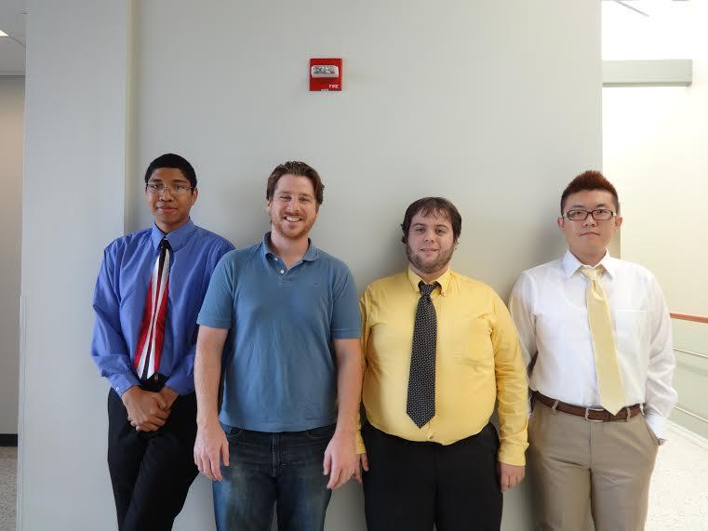
WCP52 USB Gain/Phase Analyzer
Key Personnel
Chris Pavlina- EE Student Team Lead
Kaidi Xu- EE Student
Kenneth Zachary- CoE Student
Harrison Owens- CoE Student
Prof. Kyle Temkin- Faculty Advisor
Prof. Maynard - Program Manager
[Pictured Left to Right: Harrison Owens,Kenneth Zachary,Chris Pavlina, Kaidi Xu]
2014-10-17 1

Slide 3
WCP52 USB Gain/Phase Analyzer
Executive Summary
We are creating a USB driven device that analyzes the frequency response of filters, amplifiers, and control systems and creates a corresponding Bode Plot of the analysis.

Slide 4
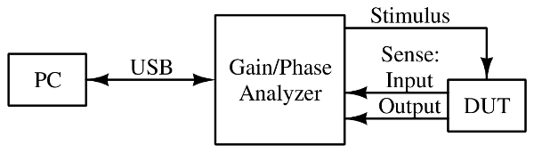
WCP52 USB Gain/Phase Analyzer
Context Diagram
2014-10-17 3

Slide 5
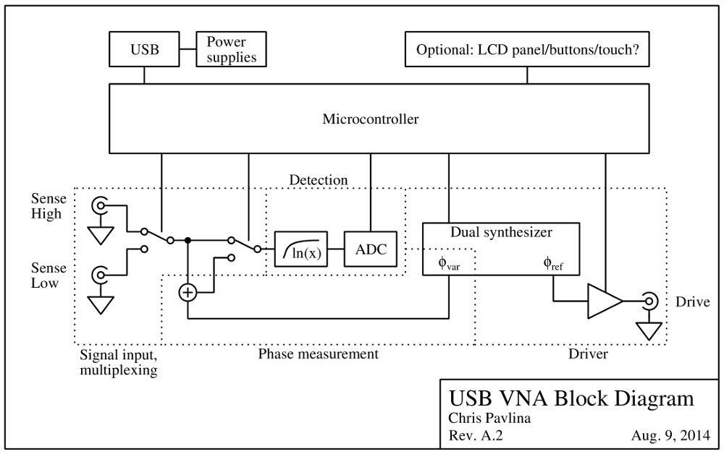
WCP52 USB Gain/Phase Analyzer
System Diagram
2014-10-17 3

Slide 6
WCP52 USB Gain/Phase Analyzer
Major Milestones Fall
100% Project Launch: 2012‐09‐21
100% Requirements Analysis / SRR: 2014‐10‐17
10% System Design / SDR: 2014‐10‐31
10% Architectural Design / PDR: 2014‐11‐14
0% Detailed Design / CDR: 2014‐12‐05
0% Interim Presentation: 2014‐12‐12
2014-10-17 4

Slide 7
WCP52 USB Gain/Phase Analyzer
Project Finances: 500$
2014-10-17 5
Items | Original Estimate | Actual to Date | Estimate to Completion | Estimate at Completion
Specialized ICs | $40 | $0 | $40 | $40
4-layer PCB | $120 | $0 | $120 | $120
Other misc. | $340 | $0 | $340 | $340
Total | $500 | $0 | $500 | $500

Slide 8
WCP52 USB Gain/Phase Analyzer
Major Issues
Still need work on EDA and layout skills
Need high level system block diagram
Whether to use op-amps or a, more complicated, transistor based design to achieve an appropriate source signal.
Need to figure out how to make the hard parts of the design a little bit easier, e.g. phase calculation.
2014-10-17 6

